Slide 1
College Bazaar
Kelly Weber, James Moir, Patrick Isho, Trevor Drozd, Spenser Grzadzinski, Alissa Barnard

Slide 2
Sprint 4 (10/14-10/25)
GCP SQL integration into Apache server
Penetration testing and system hardening on public facing IPs
Website design
Database tables

Slide 3
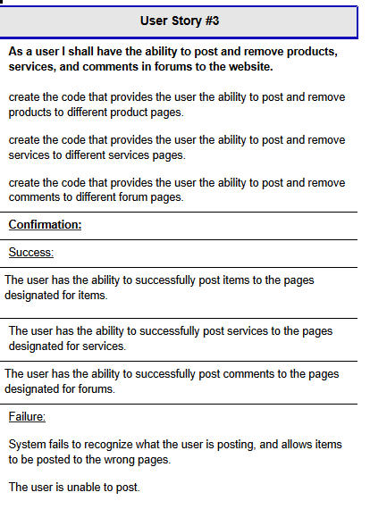
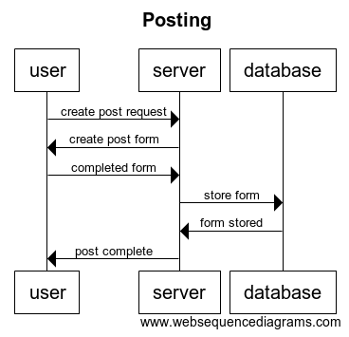
PRODUCTS
User Story #3. As a user I shall have the ability to post products to the website.

Slide 4
ACCOUNT
User Story #5
As a user I shall have the ability to view products I post and view on a private account page, and have the ability to delete.
create the code to create a user account page
Create the code so products viewed and products posted are shown on the account page.
Create the code so products viewed and products posted can be deleted from account page.
Confirmation:
Success:
User is able to view all products posted and viewed on their account page.
User is able to delete products posted and viewed from account page.
Failure:
Products viewed or posted do not show up on account page, and do not have ability to delete.
User Story #5. As a user I shall have the ability to view and delete products posted and viewed on a seperate account page.

Slide 5
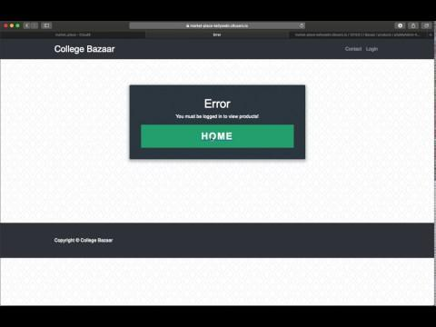
PRODUCTS/ACCOUNT DEMO

Slide 6
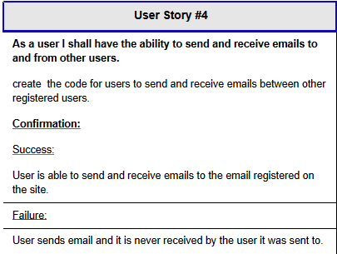
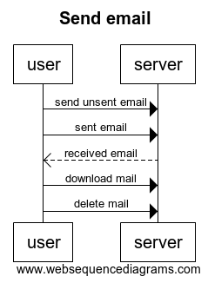
EMAIL USERS
User Story #4. As a user I shall have the ability to send and receive emails to and from other users.

Slide 7
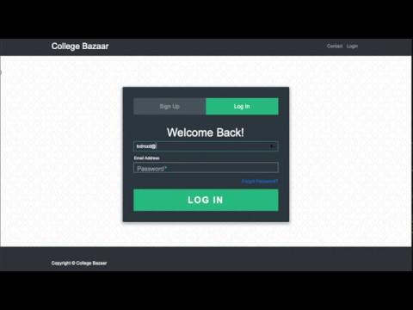
EMAIL USERS DEMO

Slide 8
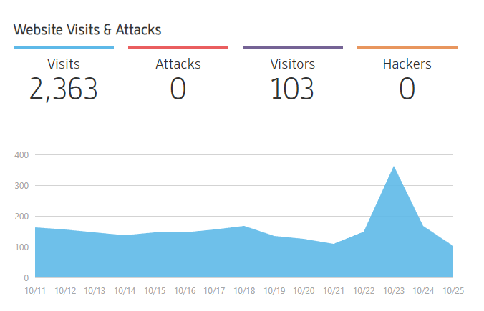
SECURITY

Slide 9
SECURITY
Fingerprinting
No PII public
Vulnerability Scanning
Protected against exploits

Slide 10
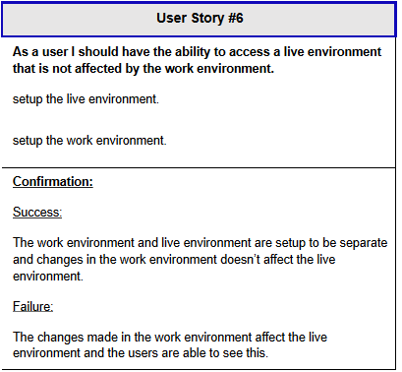
ENVIRONMENT
User Story #6. As a user I should have the ability to access a live environment that is not affected by the work environment.

Slide 11
Server Side - SQL
MySQL was installed
Now configured
Users created and permission levels set
There were problems involving permissions
Access limited

Slide 12
Server Side - PHP
PHP functionality installed
Mysqli included
Phpmyadmin installed and tested

Slide 13
Server Live Demo

Slide 14
CONCLUSION
On track with our initial sprint planning
Continuing website design to look polished and professional, and adding desired functionalities
Adding more tables to DB to store data for new functionalities
Users can now add/remove posts on their own
Email/communication between users up and running

